Slide 1


Indoor Air Quality (IAQ), Health, and Legal Liability
- HVAC Implications Since COVID-19
Webinar – Windsor/London, Ontario – 10/20/20
Jim Newman, CEM, LEED AP+, ASHRAE OPMP & BEAP, FESD, FASHRAE

Slide 2

        James L. Newman, CEM, LEED AP+, ASHRAE OPMP & BEAP, FESD, FASHRAE
        ASHRAE
          Co-Chair, IAQ Subcommittee for new Chapter on Climate Change in 2021 Handbook of Fundamentals
          Member, COVID-19 Task Force (Local)
          Distinguished Lecturer since 2010
          Former Member, now Corresponding Member, Air-to-Air Energy Recovery Technical Committee (TC), Operations and Maintenance TC
          Past Vice-Chair, Industrial Air Conditioning TC
          Member, Energy Position Committee, 2008
          Past Board Member (Local)
        BUILDING OWNERS & MANAGERS ASSOCIATION (BOMA)
          Immediate Past Chair, Sustainability for Savings Committee (Local)
          Trainer, High Performing Building Certification
        ENGINEERING SOCIETY OF DETROIT (ESD)
          Past Chair, Council of Affiliated Organizations
        U.S. GREEN BUILDING COUNCIL (USGBC)
          Founding Member, Detroit Regional Chapter
          Past Chair, Public Policy/Advocacy Committee (Local)
          Past Board Member (Local)
        AMERICAN INSTITUTE OF ARCHITECTS (AIA)
          Member, Committee on the Environment (COTE)
        URBAN LAND INSTITUTE (ULI)
          Member, Technology and Real Estate Council
Notes:
2

Slide 3
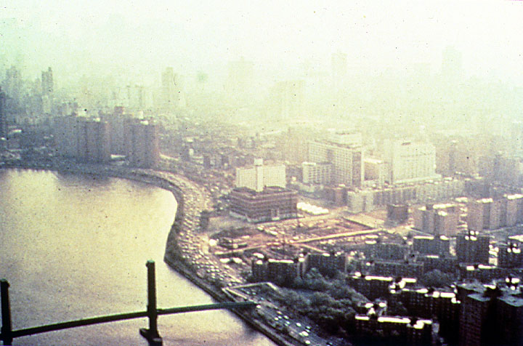
Poor IAQ
Can Have Many Origins –
Some Indoor, Some Outdoor

Slide 4
350 Building IAQ Study by NIOSH –
Problem Buildings
50% - Ventilation Problems
28% - Specific Indoor Contaminant
11% - Specific Outdoor Contaminant
11% - ???
Solving IAQ problems in commercial buildings
is not always easy.

Slide 5
What Happens to HVAC Systems as Time Passes?
Green
Gray

Slide 6
IAQ Problems
Humidity – too high/too low
Mold or mildew growth due to condensation
  Interior surfaces of walls near thermal bridges
  Carpeting on cold floors
  Locations where humidity promotes condensation
Not enough outdoor/indoor air – or unhealthy OA
Water intrusion – outdoor/indoor

Slide 7
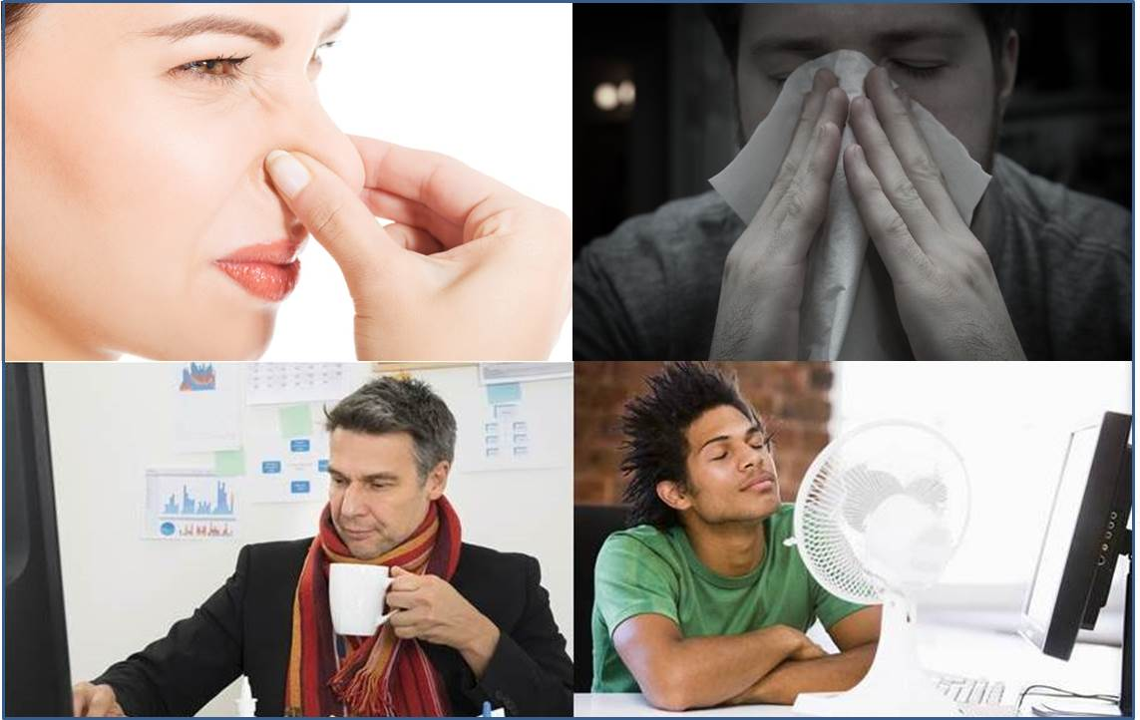
How to Know if There Are
IAQ Problems
Communicate with the people in the building.

Slide 8
Potential IAQ Problems: HVAC System
A source of biological contaminants
Surface Contamination by molds, bacteria, viruses
Interior ductwork
Odors

Slide 9
Potential IAQ Problems: HVAC Unit
Drain Pans
Improper Damper Operation
Air Filters
Coils
Surface Contamination

Slide 10
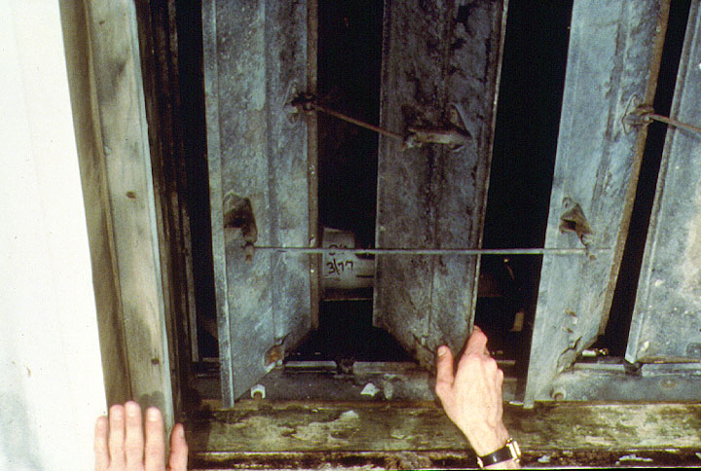
Poorly Maintained Dampers

Slide 11
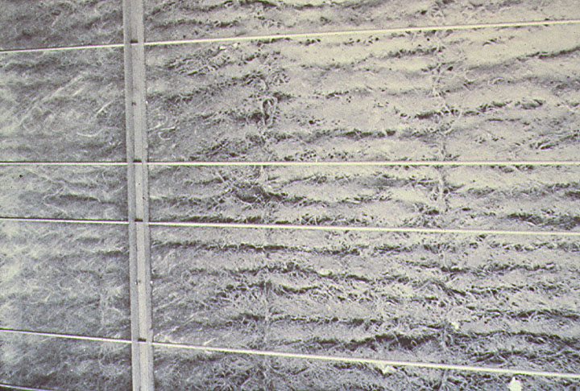
Poor (or No) Filter Maintenance

Slide 12
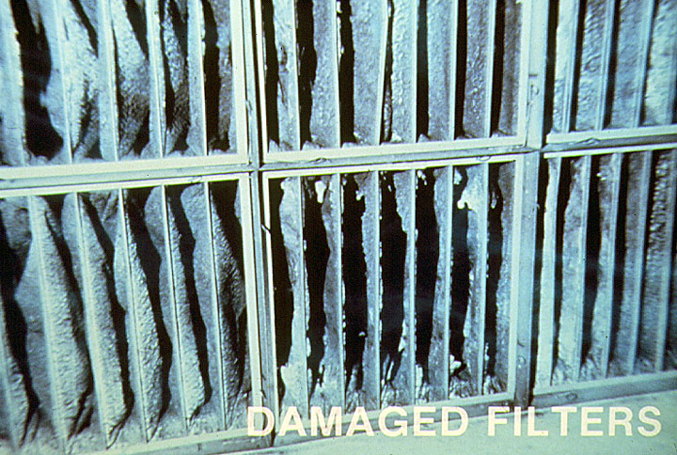
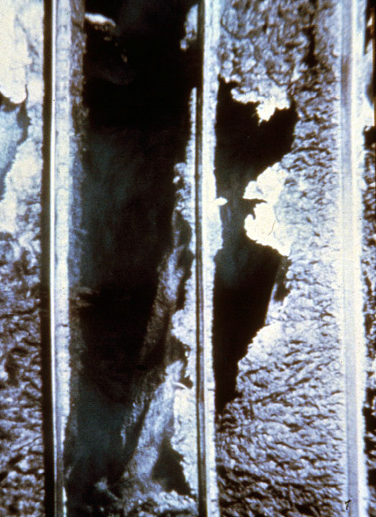
Poor Filter Maintenance Goes To Worse – This Is What Happens

Slide 13
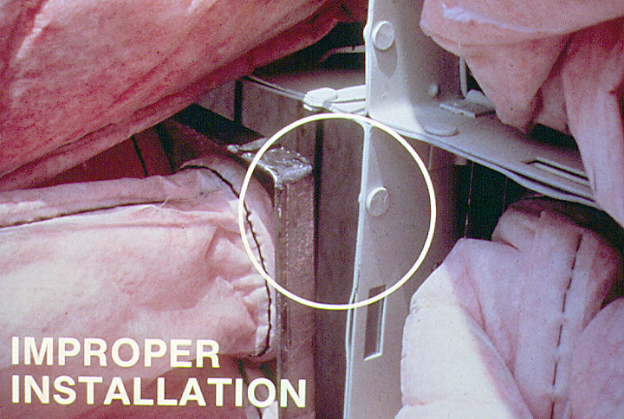
Improper Filter Installation or Replacement

Slide 14
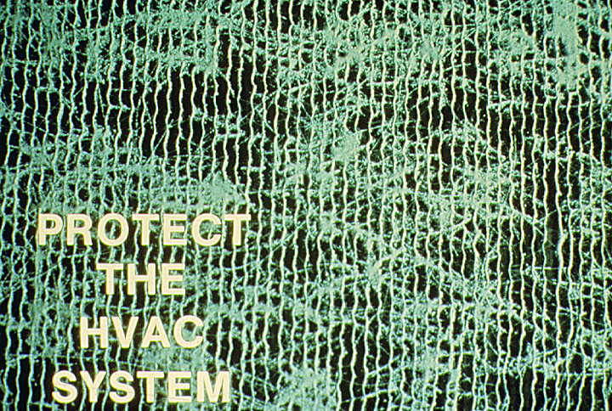
IAQ Problems – HVAC Filters

Slide 15
Liability/Litigation
Who is Blamed for Poor IAQ?
Building Owners
Architects & Engineers
Building Contractors & Suppliers
Building Management, Maintenance Personnel
Real Estate Brokers
Landlords & Tenants
Employers

Slide 16
What To Do With an IAQ
Problem – Real or Perceived
Respond Immediately!!
  If you don’t, 1 goes to 2, 2 goes to 4, etc., until you have “Mass Psychogenic Illness”
  Remember, “Perception Is Reality” to the person with the perception
Identify Problem (if there is one)
Make Necessary Corrections as Needed

Slide 17
When Should Owner Seek Outside Assistance for IAQ Mitigation?
Cannot identify the problem
Mitigation efforts have been unsuccessful
Air sampling is required
Mistakes or delays could be serious
Management feels that an independent investigation is more credible

Slide 18
Coronavirus & COVID-19
Concerns
HVAC
Relative Humidity
Filtration

Slide 19

COVID-19 Concerns
What are the facts? We’re still learning!
  “Social” Distancing – Really “Physical” Distancing
    6’ not enough
    Aerosols, droplets, etc. – Breathe, Speak, Sing, Yell, Cough, Sneeze: 4’-20’
  Face Masks
    Yes? Why, When
    No? Why, When
  Symptomatic vs. Asymptomatic
    14 days?
    28 days?
  Vaccine
    When?

Slide 20

How COVID-19 Spreads
Directly through aerosols
  Infected people breathing, coughing, sneezing
  Touching an infected person’s hand or face
Indirect Contact
  Touching surfaces like doorknobs, elevator buttons, railings, handles, etc. then touching your eyes, nose or mouth

Slide 21
Requirements – HVAC (1)
Flush with Outside Air
-100%? Or less?
Filtration
Other Methods
Humidification
  – 40-60% Relative Humidity (RH)

Slide 22
Requirements – HVAC (2)
Filtration
  MERV 13,14 Filters (Minimum Efficiency Reporting Value)
  HEPA filters (High Efficiency Particulate Air)
  Polarized Media Air Cleaners
  Carbon filters
  Ultraviolet
    UV-C (Germicidal Ultraviolet)
  Ionization
    Needle Point
    PCO (Photo Catalytic Oxidation)
    Bi-Polar (BPI)

Slide 23
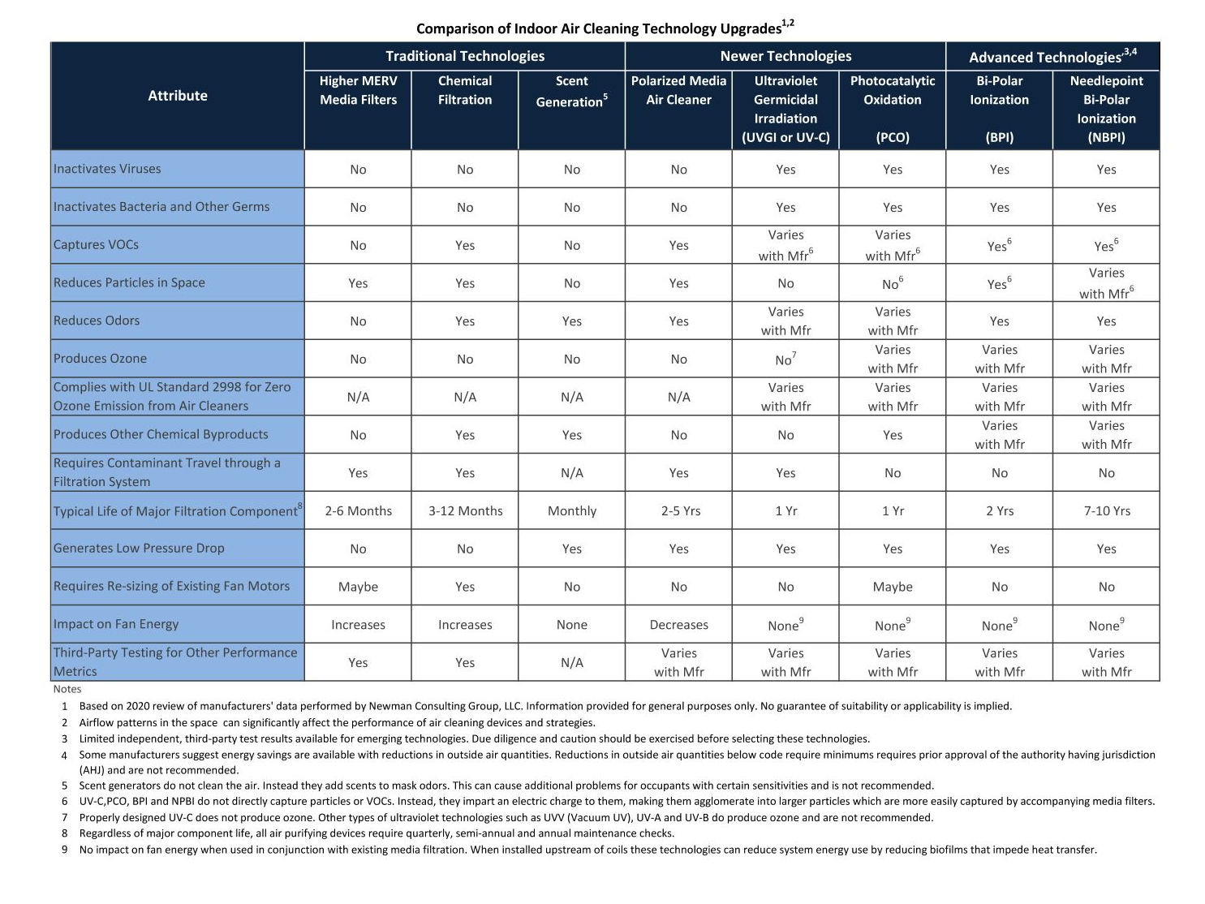

Slide 24
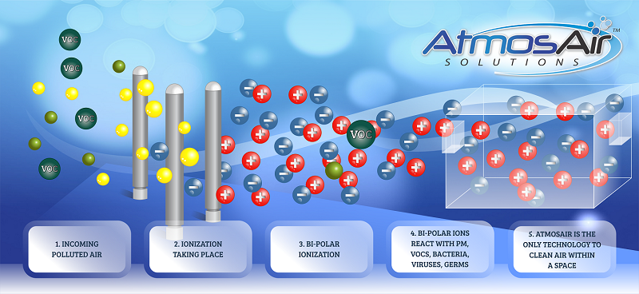
Bi-Polar Ionization (BPI)
5. CLEAN AIR WITHIN A SPACE

Slide 25
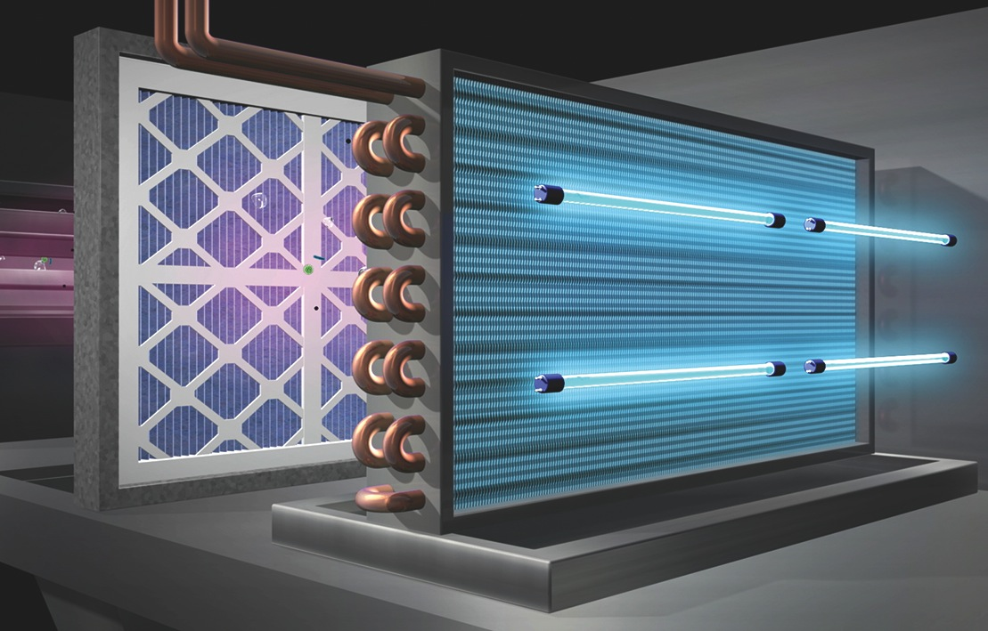
Germicidal UltraViolet (GUV)

Slide 26
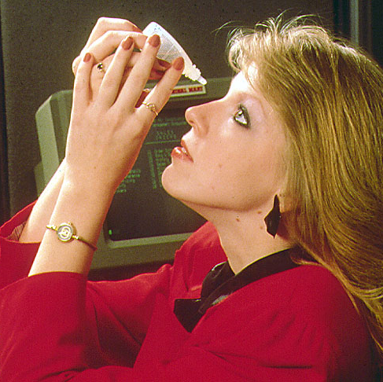
IAQ Problem: Winter Humidity
As Low As 15% In Many Buildings!

Slide 27



Pathogen Transmission
Pathogen infectivity is high when RH < 40%
Greater aerosol transmission
Evasion from surface cleaning through resuspension
Increased survival and virulence of pathogens
From Dr. Stephanie Taylor, M.D., M. Arch., CIC

Slide 28
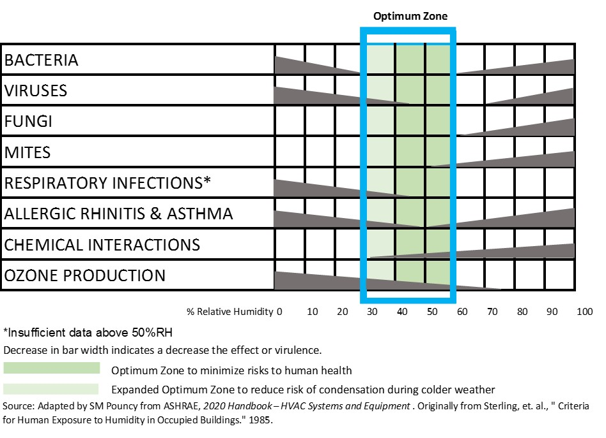

Slide 29
Infectious Droplets
Infectious droplets shrink, travel far and evade surface cleaning when the air is dry. (Taylor)
Droplet diameter in microns (um)
Float time
1
0.5
41 hours – 21 days
3
10
1.5 hours
100
6 seconds
Distance travelled:
1m
10m+

Slide 30
With healthy RH of 40%–60%, infectious droplets settle out of the airborne environment. (Taylor)
Role of Relative Humidity
Disinfection benefits of proper air hydration:
    Bedrails and other frequently touched surfaces cleaned more effectively
    Hand hygiene is maintained
    Settled infectious droplets are not re-suspended

Slide 31
Resources
Pandemic Resources: NewmanConsultingGroup.us/web-sites
Government & Industry Resources:
AIA Committee on the Environment - www.aia.org
ASHRAE - www.ashrae.org/covid19
Building Owners &Managers Association - www.boma.org
CDC – Indoor Environmental Quality - www.cdc.gov/niosh
EPA – Indoor Air Quality - www.epa.gov
IAQA – Indoor Air Quality Association - www.iaqa.org
US Green Building Council - www.usgbc.org
World Green Building Council - www.wgbc.org

Slide 32
Liability/Litigation
Who is Blamed for Poor IAQ?
Building Owners
Architects & Engineers
Building Contractors & Suppliers
Building Management, Maintenance Personnel
Real Estate Brokers
Landlords & Tenants
Employers

Slide 33
“The greatest challenge we face today is failure to adapt to change”
Tim Wentz, ASHRAE President, 2016-17
For Further Information:
James L. (Jim) Newman
JimN@NewmanConsultingGroup.us
www.newmanconsultinggroup.us
+1-248-626-4910

